Slide 1
ZOOM for Congregational Use
2
+
2
+
Together, while apart

Slide 2
Why zoom?
2
+
2
+
Gathering Community

Slide 3
What “Free” zoom brings
2
+
What to expect in “free” Zoom:
Reaching out to everyone who has web access or even just a telephone
Up to 100 users logging in simultaneously in an interactive setting
Up to 40 minutes of live streaming (you will be cut off after that and would have to re-start your meeting)

Slide 4
What “Free” zoom brings
2
+
What to expect in “free” Zoom:
You can record the session directly to your computer, if you would like to save it for future viewing (during setup of meeting)
You receive a phone number for those who wish to dial-in
You create a link that is shareable, so that you can tell others where to go or how to dial in, BEFORE the video session begins

Slide 5
“HOW TO” Basics
2
+
Follow these simple steps
Go to zoom.com
Sign up for the FREE account
Click on My Account
Click on Schedule a Meeting
Fill out the appropriate information describing the event, the event date & time

Slide 6
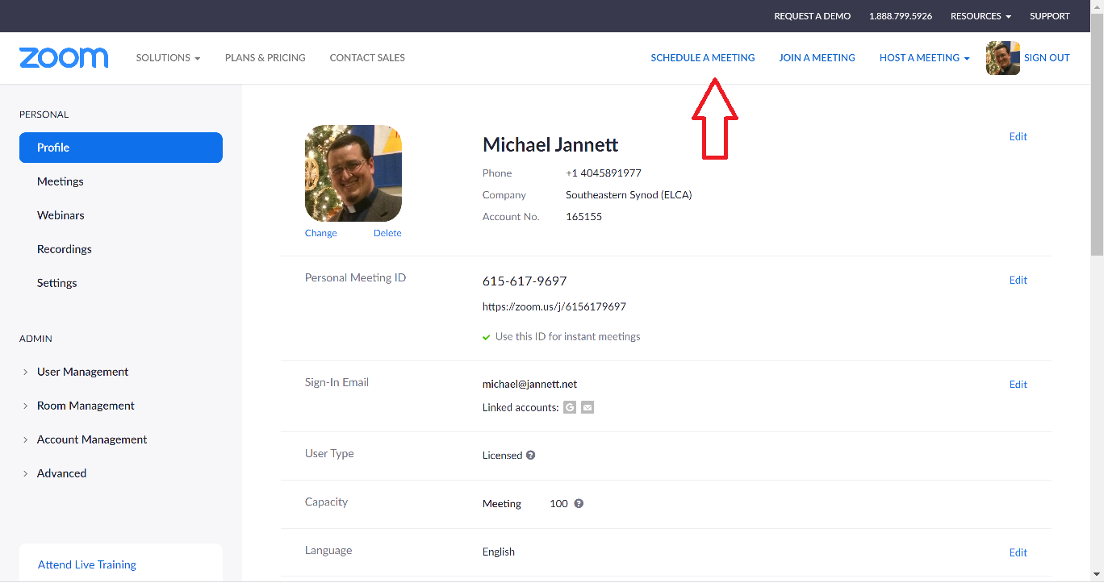

Slide 7
Setting up the meeting
2
+
Keep these in mind
Keep in mind the time zone you are in and set the appropriate time
Decide if you would like a special meeting ID or let Zoom create one for you
I would NOT set a meeting password
Under Meeting Options:
I would check “Enable join before host” otherwise, no one can login until you – the host – logs in
If you wish to record the meeting, click “Record the meeting automatically”

Slide 8
Live Demo
Schedule a Meeting

Slide 9
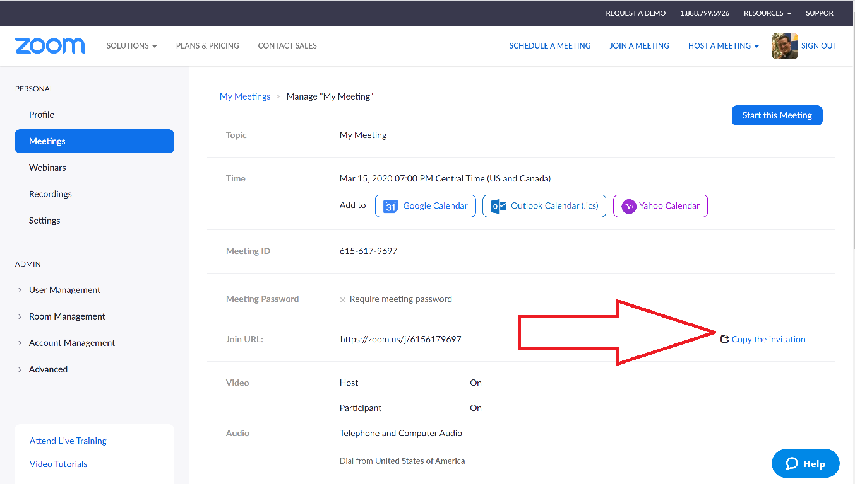

Slide 10
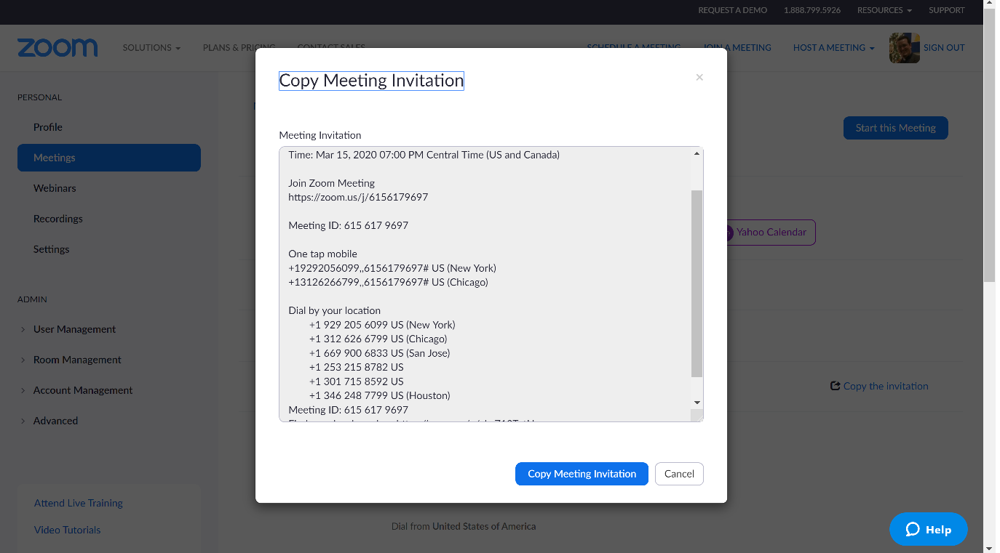

Slide 11
Zoom meeting tips
2
+
Helpful Hints
MUTE option: recommend all participants be MUTED if you have a large gathering, to avoid background noise. (Use your discretion)
Make sure someone is guiding the meeting. This person will call on folks and will lead the agenda

Slide 12
Recommended that all participants MUTE,
especially when large numbers are gathered

Slide 13
Pr. Michael Jannett Assistant to the Bishop for Formation and Communication mjannett@elca-ses.org
ELCA-ses.org
2
+

Slide 14
THANK YOU
2
+
2
+
Go in Peace. God is with you!

